Slide 1
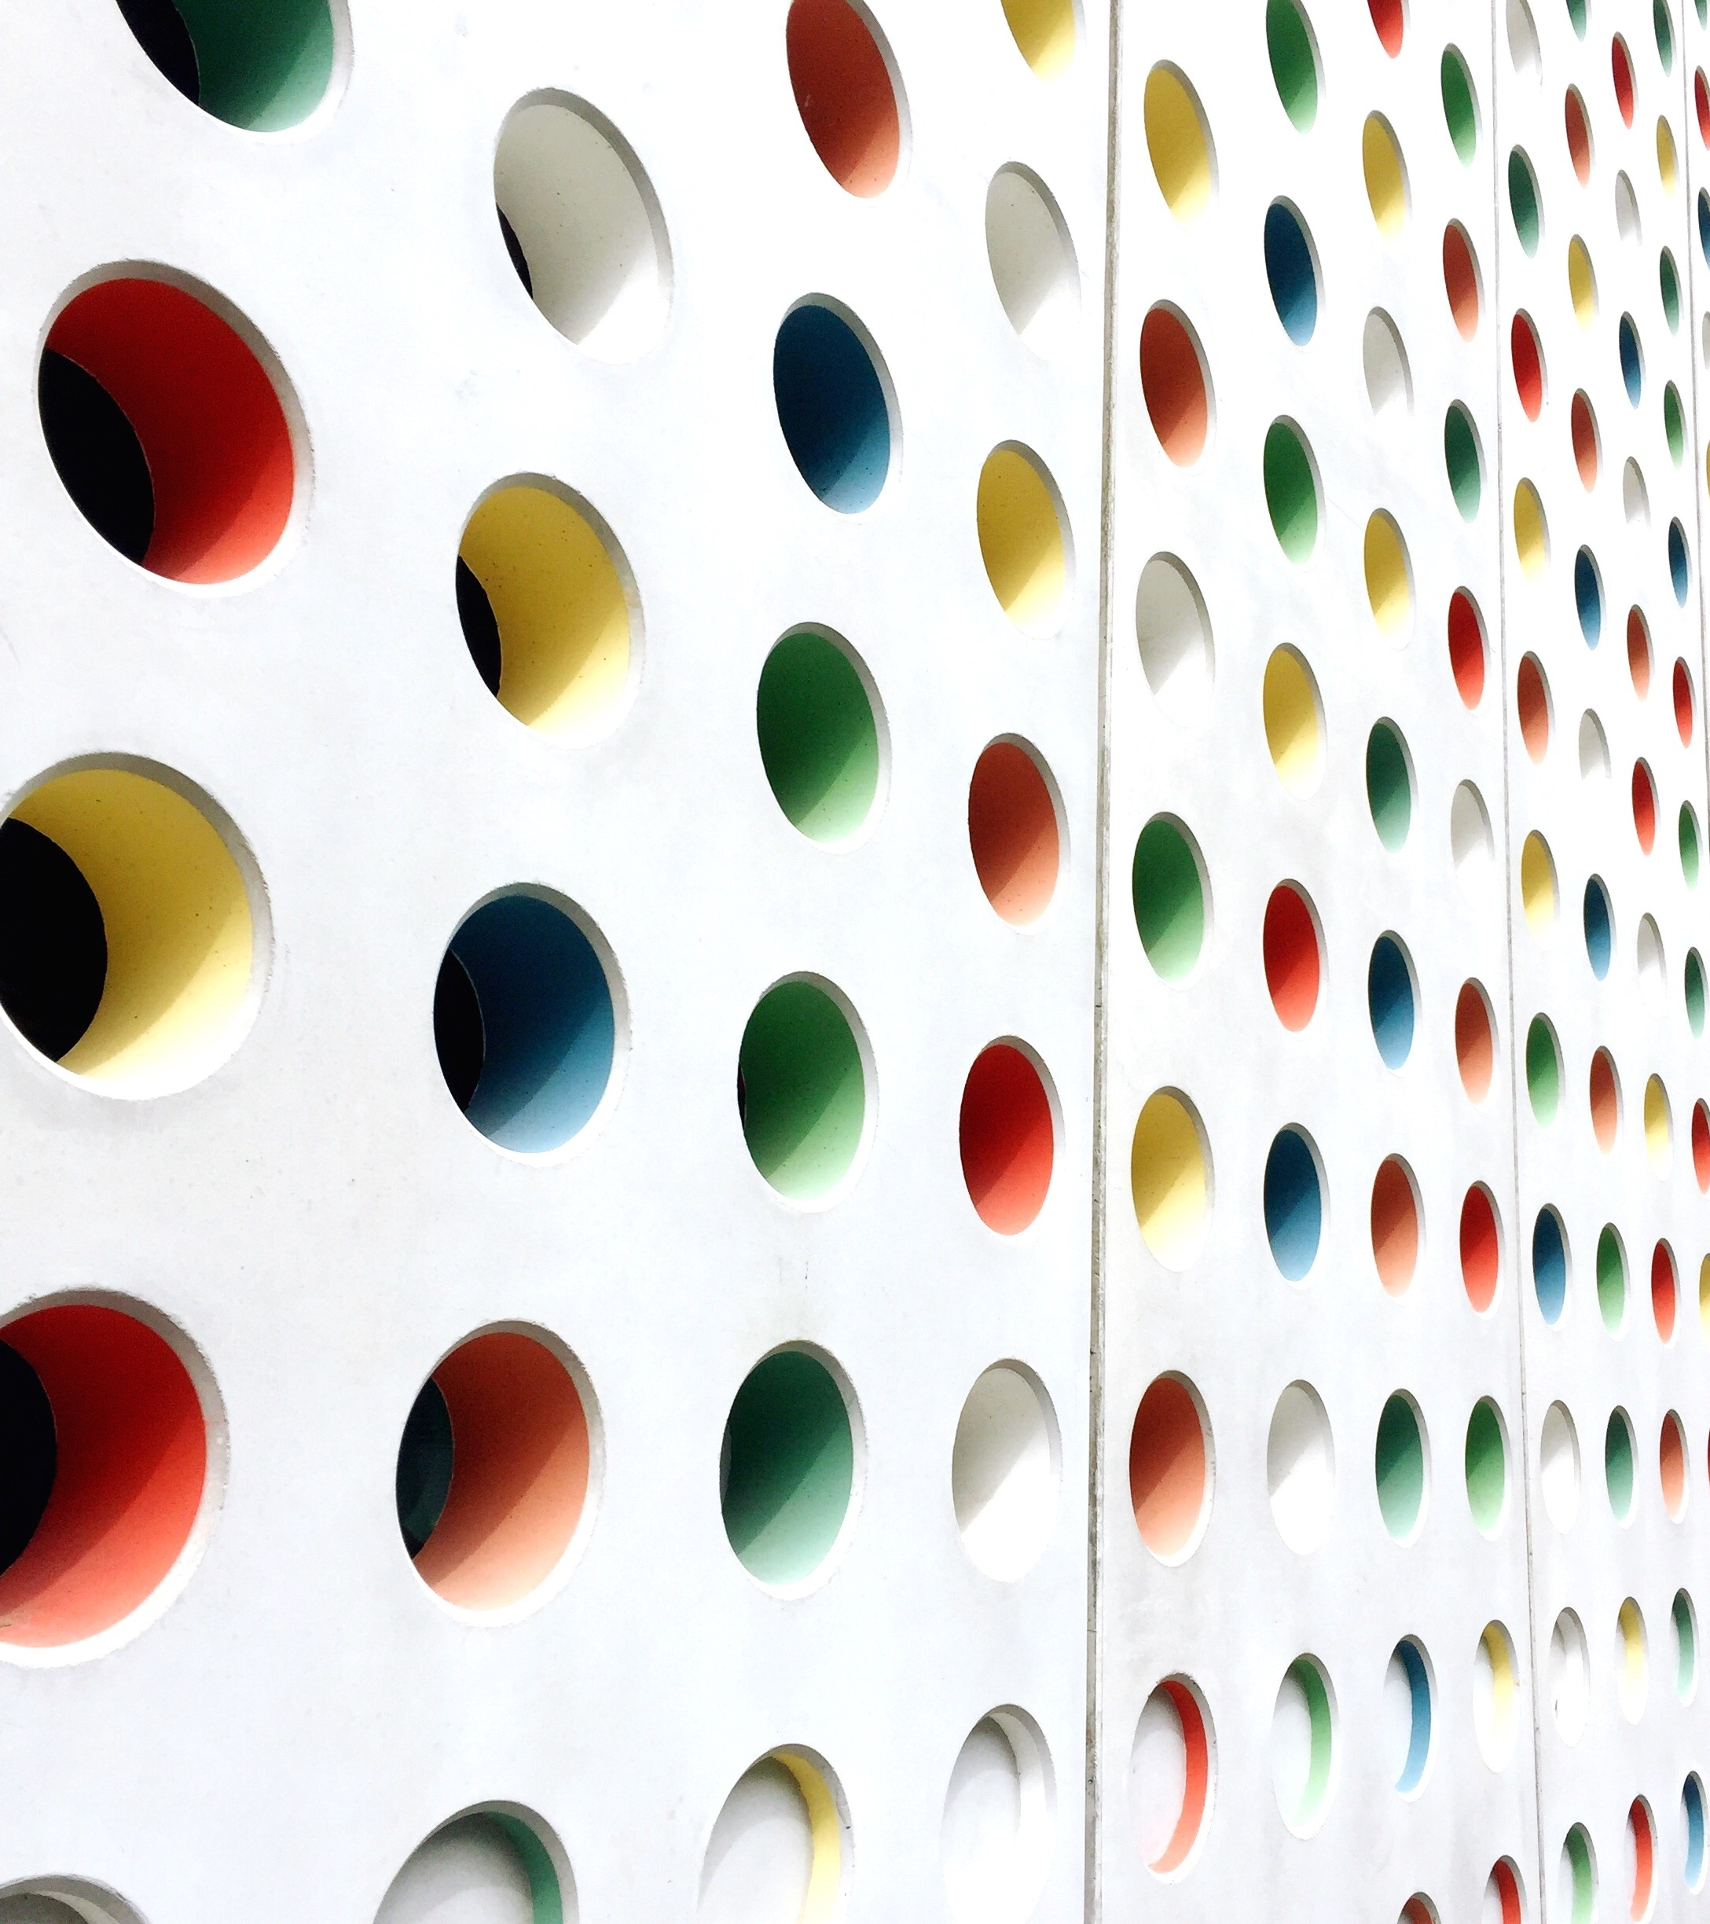
Plastic Waste Management
Team Members:
Sachin Rajbhar
Harshita Shokeen
Ritik kumar

Slide 2
Some facts
10-15 plastic wrappers thrown in home dustbin
100 plastic containers, bottles are thrown at our college campus
the country generated 25,940 tones of plastic waste every day.
According to the report, Kolkata and Chennai occupy the second and third spot among metropolitan cities for daily plastic waste generation with 429.5 TPD and 429.4 TPD, respectively.
Only 60% of the total plastic waste is being recycled.
Households generate maximum plastic waste, of which water and soft drink bottles form a large number.

Slide 3
Effects On Environment
1. TAKES UP SPACE & KILLS TERRESTRIAL WILDLIFE
Plastic pollution causes harm to humans, animals and plants through toxic pollutants. It can take hundreds or even thousands of years for plastic to break down so the environmental damage is long-lasting.
2. KILLS OCEAN LIFE
It affects all organisms in the food chain from tiny species like plankton through to whales. Toxins work their way up the food chain when plastic is ingested and can even be present in the fish people eat.

Slide 4
3. PRODUCES CHEMICAL POLLUTION
Plastics are essentially made from oil and gas. Mining these nonrenewable resources produces harmful chemicals like benzene, toluene, ethylbenzene, xylene, carbon monoxide, hydrogen sulfide, ozone, sulfur dioxide, and many more.
4. CREATES MICROPLASTICS
“plastics don’t break down.” This is partially true; plastics don’t break down like organic materials do.
Organic materials, like paper, cotton, hemp and many others decompose into nontoxic substances. In a sense, plastics do break down; they break into much smaller plastic particles now known as microplastics.
These small particles pollute waterways, soil, plants, animals and humans.

Slide 5





Solution
How can you reduce the amount of plastic use?

Slide 6



